Slide 1
Team 14: DNS using Chord in DistAlgo
Problem: DNS measurements at root and TLD name servers show that they handle a large load and are frequently subjected to denial of service attacks
Goal:
To solve this problem by implementing DNS on top of Chord.
Compare performance of two best Implementations written in - Java (OpenChord) and DistAlgo

Slide 2
Implementations
Made the existing Chord Implementation compatible with the latest Distalgo version.
Understood the Open Java Chord Implementation and added a temporary node failure feature.
Implemented a Driver to Perform Following function.
Create and Delete Nodes
Perform Lookup queries
Perform probabilistic failure of running nodes
Calculate the performance metrics.

Slide 3
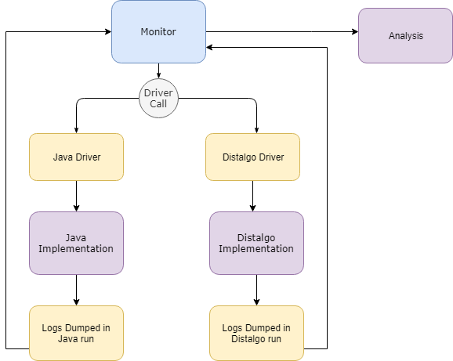
Implementation Architecture

Slide 4
Performance and Correctness Evaluation
Calculated Average Latency, Hop Counts, Successful Lookup Ratio and Average Timeout Ratio for both implementations by varying the following parameters:
Stabilize Delay (sec)
Fix-finger Delay (sec)
Successor List Size
Check Predecessor delay (sec)
These features were taken from following papers:
https://www.cs.cornell.edu/people/egs/714-spring05/mitdns.pdf
https://pdos.csail.mit.edu/papers/ton:chord/paper-ton.pdf
https://link.springer.com/content/pdf/10.1007/978-3-540-30189-9_17.pdf
https://tinyurl.com/ycsv5tvj

Slide 5
Demo Video
Link - https://drive.google.com/open?id=18hBq-HFugjnqibMbzA9O9wAlwm41egle

Slide 6
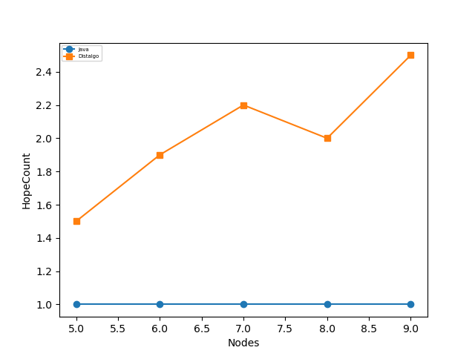
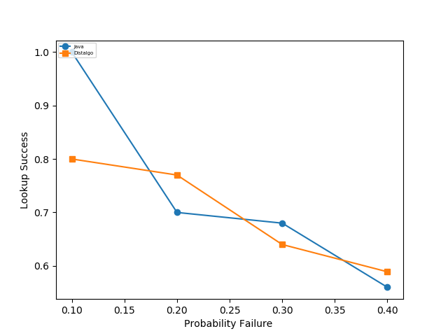
Results

